Slide 1

E-Learning Web Application
Aagya Singh - 20104076
Aditya Waingade - 20104099
Adarsh Singh - 20104080
Project Guide
Ms. Charul Singh

Slide 2
Contents
Introduction
Objectives
Scope
Proposed System
Project Outcomes
Technology Stack
Block Diagram
Use Case
Implementation

Slide 3
1. Introduction
An eLearning project aims to create an engaging and informative online course platform that helps learners achieve the desired learning outcomes.
Problem Identified :
    The traditional mode of learning is inflexible and has time constraints.
    The geographical concerns bothered the users in a significant way
  Solution Proposed :
    The online mode of learning is flexible,efficient,self-paced.
    It provides same quality of education to all the users.
    Students, through the use of the internet, can easily study their programmes via a new instructional medium. E-learning educates people of all different ages

Slide 4
2. Objectives
To get over the traditional methods of learning.
To automate the procedure of studying notes online.
To provide inexpensive and efficient learning process.
To provide trouble-free mode of education.
To introduce an alternative to offline mode of education.

Slide 5
3. Scope
Can be useful for all kind of inquisitive students who are looing forward to study informational courses.
Can be used by the passionate professors who are in search of online platform based learning.
Can be used by people of all the ages.
Can be used without time and location constraints.

Slide 6
4. Literature Survey
Fischer et al.(2015) studied how proceedings of scientific conferences can be used for trend studies in the field of e-learning.
Moravec et al. (2015) showed how e-learning tolls impact students' achievement.
Scholtzland Kapeso (2014) and Almajali et al (2016), Shannak (2013) explored the factors of mobile learning.

Slide 7
4. Proposed System
Feature 1: More Cost-Effective :
    Online learning is priced lower than traditional university courses and is also worth the cost.
Feature 2: Web-Based Learning:
    As time goes on and social distancing rules become more concrete in everyday life, it’s expected that web-based learning will experience a surge.
Feature 3: More Students Can Enroll At Once
    Online learning classes that depends on pre-available courses can have an unlimited number of students enrolling.
Feature 4: Online Learning Offers Convenience And Flexibility
    Most professionals found they couldn’t continue with their education or upskilling because they couldn’t fit studies around their work schedules.

Slide 8
5. Project Outcome
Mentioned what will be the final output of project pointwise
e.g.
Users can log in to access the services provided.
Users can register themselves.
Users can access the course catalogs for a specific course.
Users can transform themselves through independent learning.
Users can get expert teaching and learning facilities.

Slide 9
6. Technology Stack
Write what you have planned to develop front end ( GUI ) & Backend (Database if applicable)
- HTML
- CSS
- JAVASCRIPT
-Firebase

Slide 10
7. Suggestions in review-1
Changes in UI design
Backend Connectivity
Proper explanation of ppt
Changes input
Adding filters
14/09/22

Slide 11
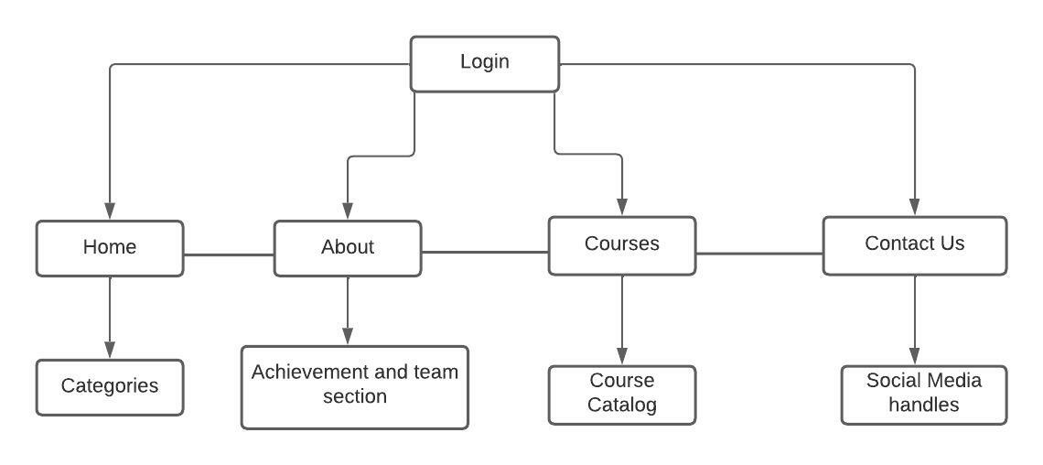
7. Block Diagram

Slide 12
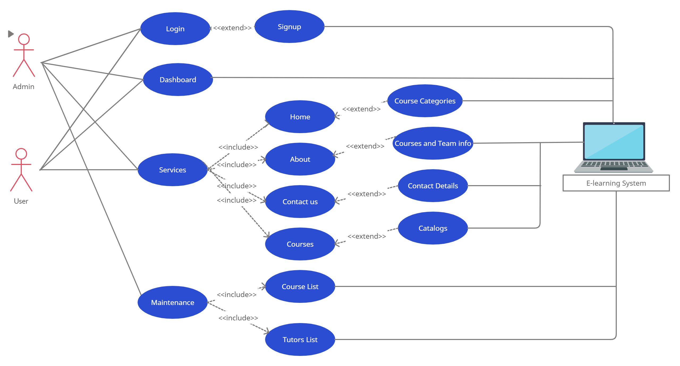
8. Use Case

Slide 13
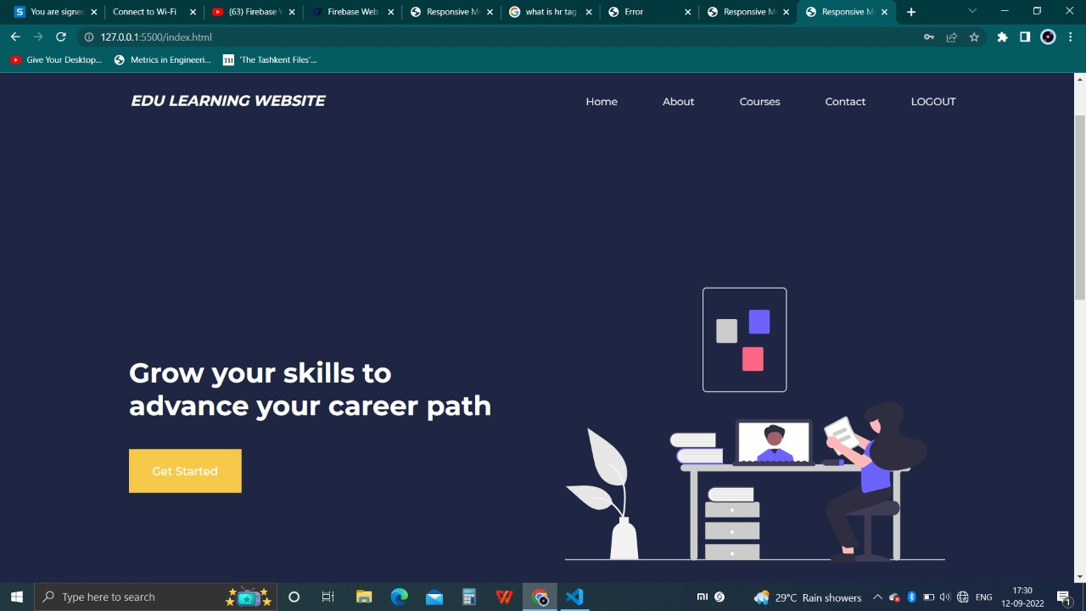
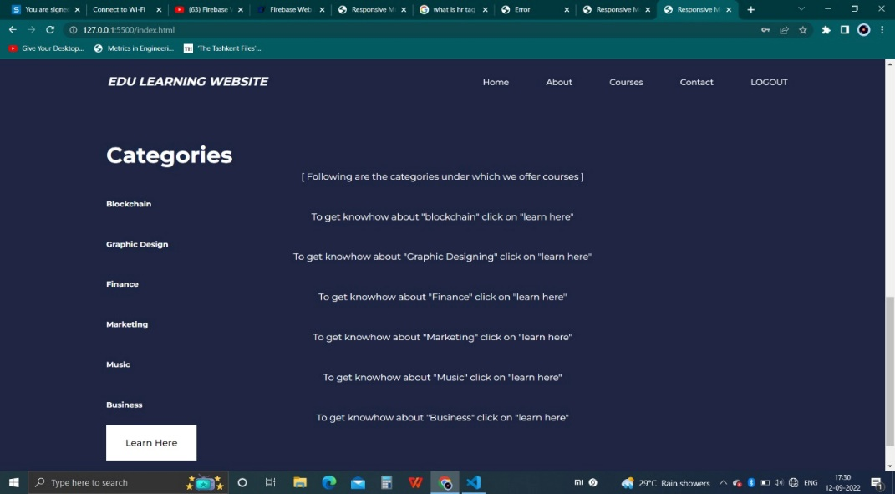
8. Result and Discussion

Slide 14
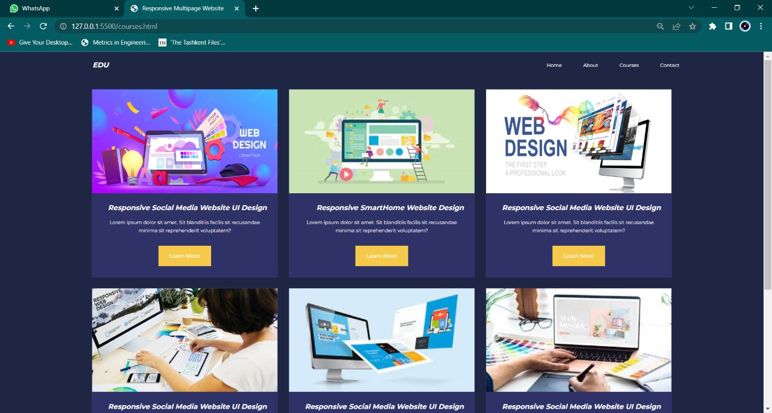
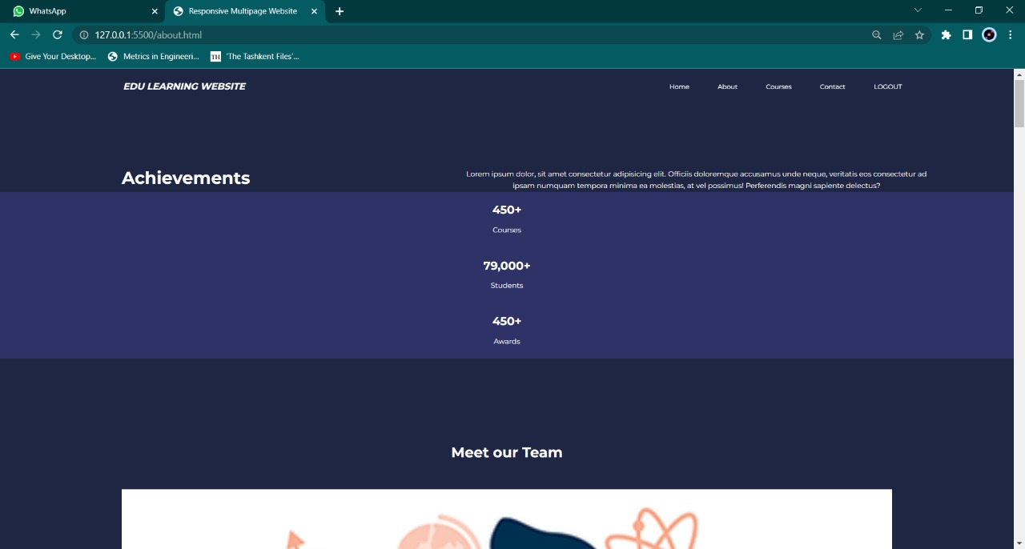

Slide 15
8. Conclusion and Future scope
Conclusion:
This E-learning platform that provides course access to the learners which can be accessed according to their convenience.
Future Scope:
The future scope of e-learning education in India is in fact much wider with many e-learning or ed-tech companies are stepping ahead in providing this service.
The future of E-learning industry in India seems to be vibrant as number of Internet users are rising in this country.
14/09/22

Slide 16
Thank You...!!

